Slide 1


VIR_PIANO
Virtual Piano
Presented To
Cynaptics club IIT Indore
Presented By
Srujan
Prachi Patil
Prkhar Mishra
Abhinav Gangil
Mentors -
Vishnu Jaddipal
Samip Shah

Slide 2


Agenda
1 | Hand Pose Detection
2 | Keyboard initialistaion
3 | Tap Detection
4 | Sound Playing
The PS was to make a piano that can be played anywhere for individuals to learn more about music and to enjoy it

Slide 3
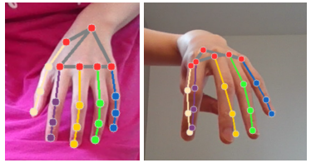
Hand Pose Detection
Real - time tracking by using RGB image from the webcam.
We utilized MediaPipe hands API to predict the 3D hand key positions in real time
Predicted 3D locations of 21 keypoints for both the hands.
Predicted coordinates using Mediapipe

Slide 4
Write a project phase
or milestone here.
Key Board Initialisation
Prepared the keybord to be used by the user.
Bounding box Detection
Piano
Placement
Taking coordinates from the user based on the index and the thumb with middle finger for fixing the keyboard.
We made function which takes input all the necessary parameters(points,number of octaves) as input and displays keyboard on the image.

Slide 5
Prespective transformation
We additionaly added the top view for the convinence of the user
Top view
The top view was made by using prespective transformation on the coordinates obtained from mediapipe

Slide 6
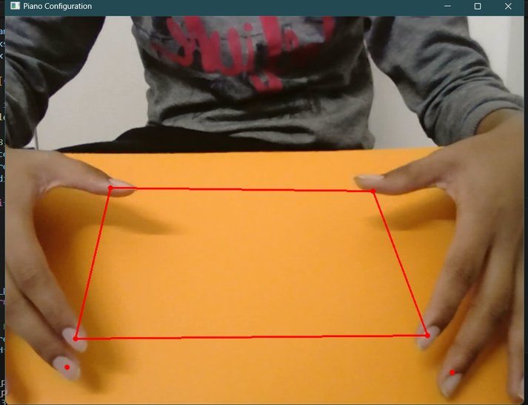
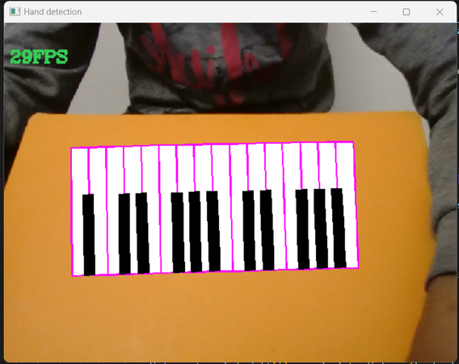
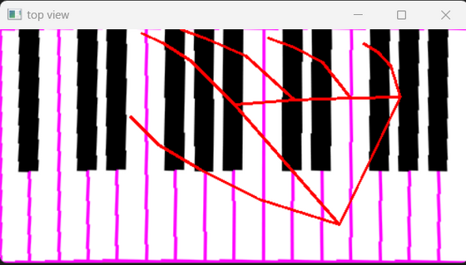
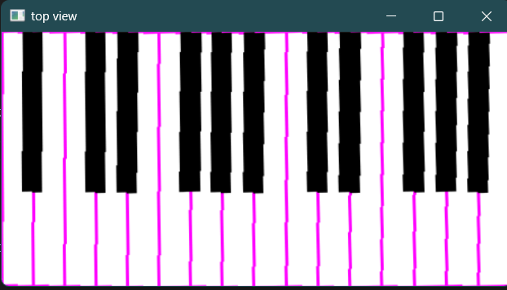
Perspective Transformation
Front View
Top View

Slide 7
Tap Detection
Check threshold
key Detection
we take change in y coordinate and if the difference is greater than certain threshold then then the tap is detected.
Determine if the finger whose threshold is cleared is present in the bounding boxes of the the keyboard.

Slide 8
Sound Playing
Detected keys
we get a list of keys to be played.
PyGame for Sound playing
Pygame comes with a module called mixer with
which we can play audio files
Avoiding interference
This occurs when the same key is pressed for a vey long time. we removed such problems by checking for the last key.

Slide 9
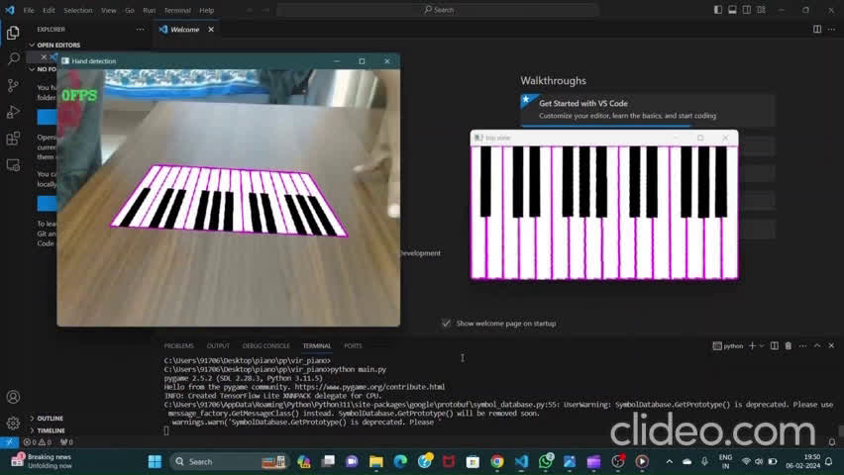
Demo Video
Github Link -https://github.com/NAGAMALLYSRUJAN2329/vir_piano

Slide 10
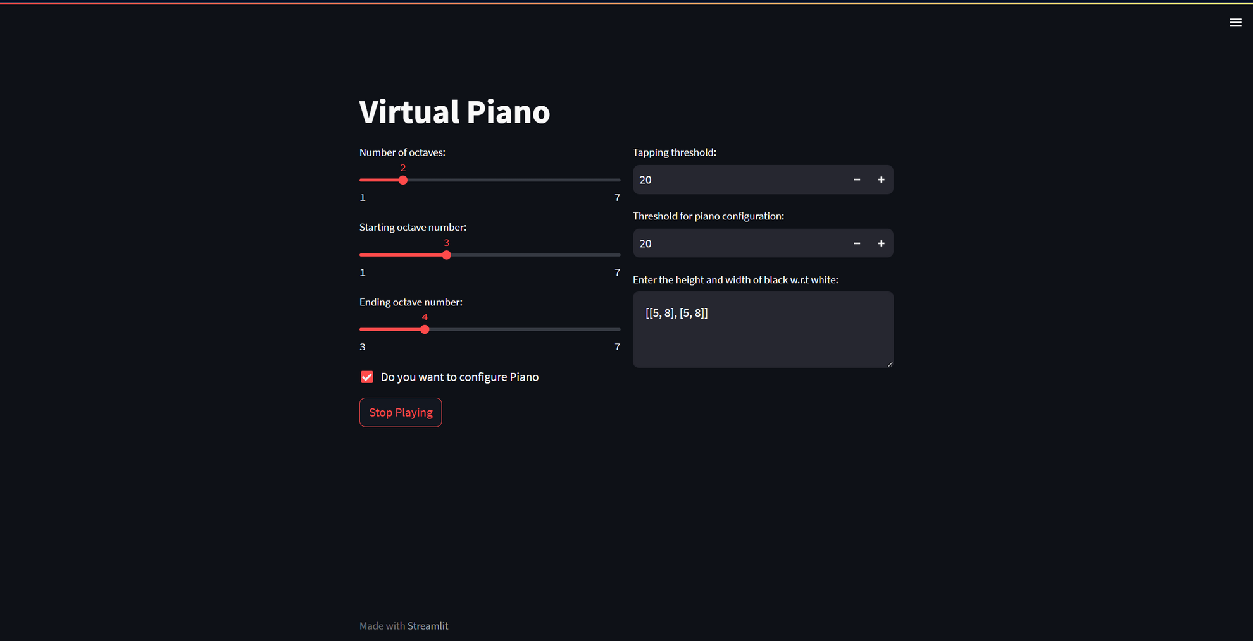
User Interface

Slide 11
Future Works
1 | Enhancing Frame Rate (FPS): Implementing an advanced model to increase the frames per second (FPS) for improved real-time performance.
2 | Refining Tap Detection: Implementing enhancements to tap detection algorithms to optimize accuracy and responsiveness.
3 | Enhancing Top View: Improving the top-view perspective to provide a more user-friendly representation of the environment.
4 | Surface Detection and Keyboard Alignment: Implementing algorithms for detecting flat surfaces and dynamically aligning the virtual keyboard to enhance user experience.

Slide 12
5 | Optimizing User Interface: Designing and implementing a more intuitive and user-friendly interface to enhance overall user experience and interaction with the system.
Future Works

Slide 13


